Slide 1

Real-time Location Tracking and Visualization using Augmented Reality
Aadam Hamza Saeed

Slide 2
Augmented Reality
A type of of technology that superimposes virtual objects onto the real-world.
Virtual reality replaces the reality with a virtual one, while AR augments the reality.
What is Augmented Reality?
How is it different from Virtual Reality?

Slide 3
The problem
Motivation
Context
Problem statement
Augmented Reality is a new technology that could be used to provide a better user experience.
AR could be very effective in displaying location markers superimposed onto the real-world.
Imagine you are in a crowded space and you want to find your friend quickly. Typical location tracking apps would only display a marker in 2D screen, with low accuracy. AR could be very beneficial in such a case.
Keep track of a user’s location and send location updates to his contacts in real-time.
Use Augmented Reality to visualize location markers so we could quickly locate a user in a crowded space.

Slide 4
Challenges deep-dive
Challenge 1
Challenge 2
Challenge 3
User Account Management
User should be able to register, log-in and log-out. Using Multiple Authentication providers will be preferable.
Location Tracking
Keep track of user’s location and store it in a remote database. Update the location of a user for all his contacts in real-time.
Contacts Management
Users should be able to add and remove one another as their contacts, so they could keep track of one another.

Slide 5
Challenges deep-dive
Challenge 4
Challenge 5
Challenge 6
Augmented Reality
Use Augmented Reality, if it is supported on the end-user’s device, to visualize the location marker of a user in real-world.
Real-time Chat
Add chat functionality into the app so users could easily communicate when navigating, without leaving the app.
Chat-Bot Integration
Integrate a chat-bot into the application so it could answer common queries, and provide an effective and enjoyable experience to the users.

Slide 6

Implementation

Slide 7
User Account Management
Firebase Authentication provides backend services, easy-to-use SDKs, and ready-made UI libraries to authenticate users.
Register, Login, Logout

Slide 8
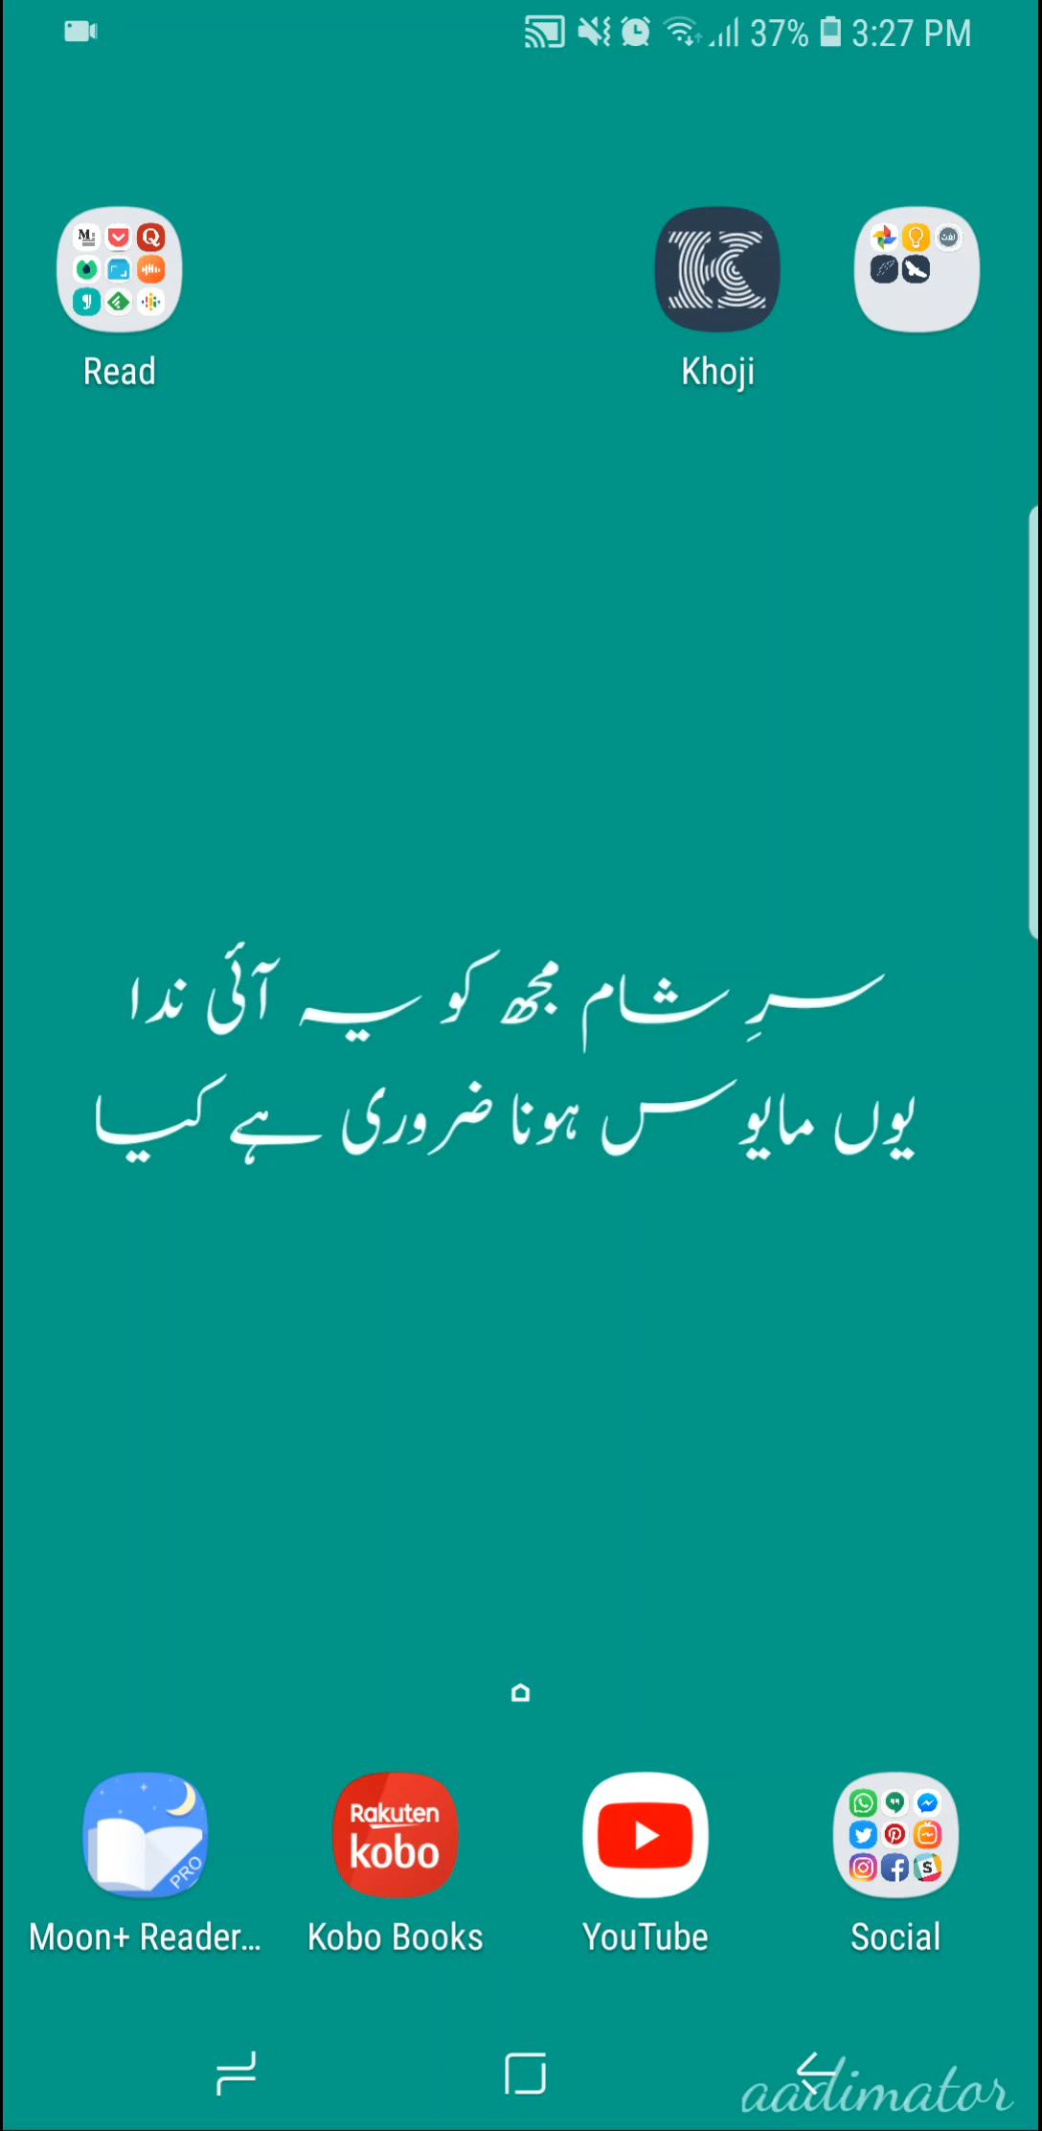
User Account Management
We use Firebase Authentication to authenticate users. Multiple authentication methods are used:
Email
Google
Facebook
Twitter
Once a user has signed up, the service returns a unique identifier (uid) for that particular user.
We store the uid, name, email, and photoUrl of the user in our remote Firebase Database, as these are used throughout the application.

Slide 9
Location Tracking
Keep track of a user’s location and update it in the remote database periodically.
And saving in the remote database

Slide 10
Location Tracking
If the location is turned off, prompt the user to enable the location updates.
By following the best practices, we used FusedLocationProvider, which uses GPS, WiFi, cellular network, etc. to get the best accuracy for a user’s location.
Android 8.0 introduces new limitations for increased battery performance of the user’s device.
We created a service that tracks a user’s location in the background and updates it in a remote Firebase database.

Slide 11
Contacts Management
Users are able to add and remove one another from their contacts lists.
Adding/Removing users into a contacts list

Slide 12
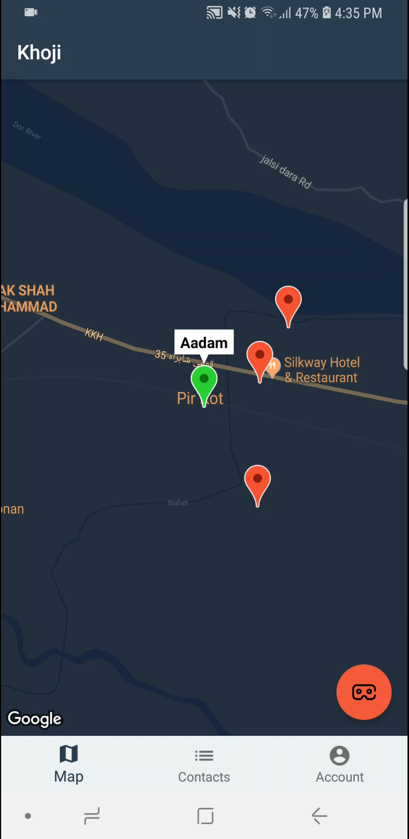
Contacts Management
Users can add one another to their contacts lists by using the email address. If there’s a user with that email id, it will get added to the contact list.
Once a user has been added to the contact list, the contact list will get updated for both users and they will be able to receive location updates for one another.
User can also start to chat with other users in his contact list.
Tapping the name or image of a contact will take the user to his location marker on the map.

Slide 13
Augmented Reality
We faced numerous problems during the implementation of this feature:
New Library
Unstable markers
Inaccurate Location
API changes
GPS based markers
Problems and Solution

Slide 14
Augmented Reality
We used the latest version (v1.3 at the time) of ARCore library to implement AR features in android.
To place AR markers in the real-world, based on their GPS coordinates, we used ARCoreLocation library, which is another, relatively new, open source library.
If the device supports AR, user will be able to see the button so he could launch the AR activity.
Once the activity is launched, we fetch the latest location details of the contacts from the remote database and place AR markers on those coordinates. After that, we actively listen to any updates in the database and as soon as the location of the contact changes, it gets reflected in AR marker as well.
User can choose to see the markers for, either a single contact or all of his contacts.

Slide 15

Augmented Reality
Single contact AR marker

Slide 16

Augmented Reality
All Contacts AR markers

Slide 17
Real-time Chat
Users should be able to communicate with one another easily, when navigating, without having to leave the app.
In-app messaging

Slide 18
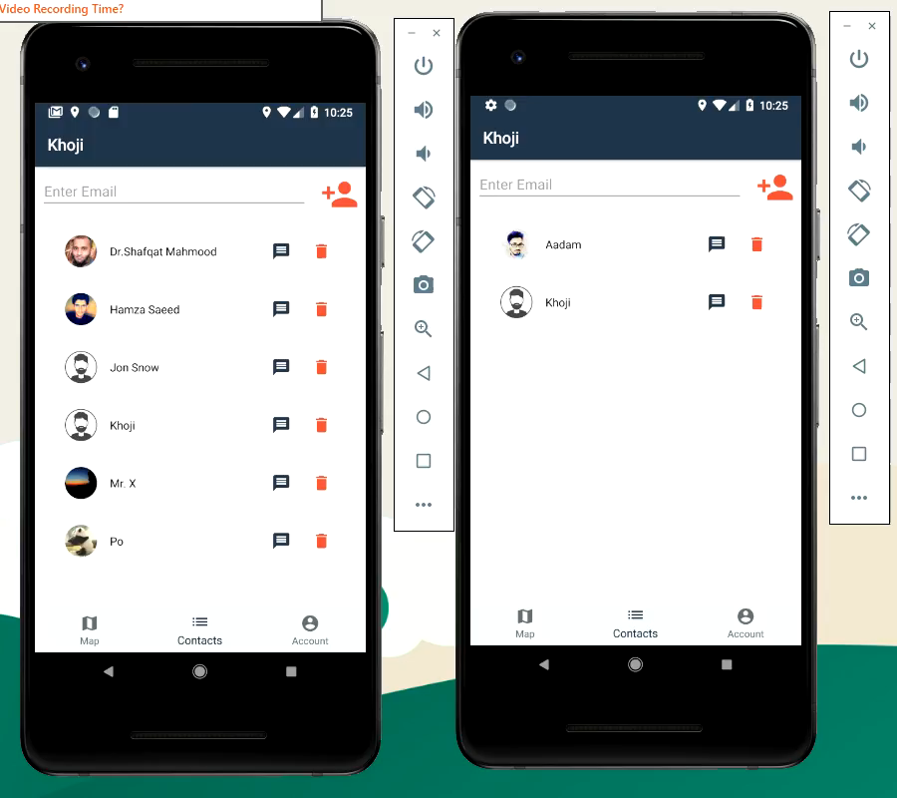
Real-time Chat
We use Firebase Realtime Database to store and update the messages in real-time.
Separate rooms are created for each user pair that starts to chat.
Now, users don’t have to leave the app in order to communicate with the other. This results in increasing the utility and efficiency of the application.

Slide 19
Chat-Bot Integration
Add a chat-bot so user can ask common queries and get help and tips on using the app effectively and have an enjoyable experience.

Slide 20
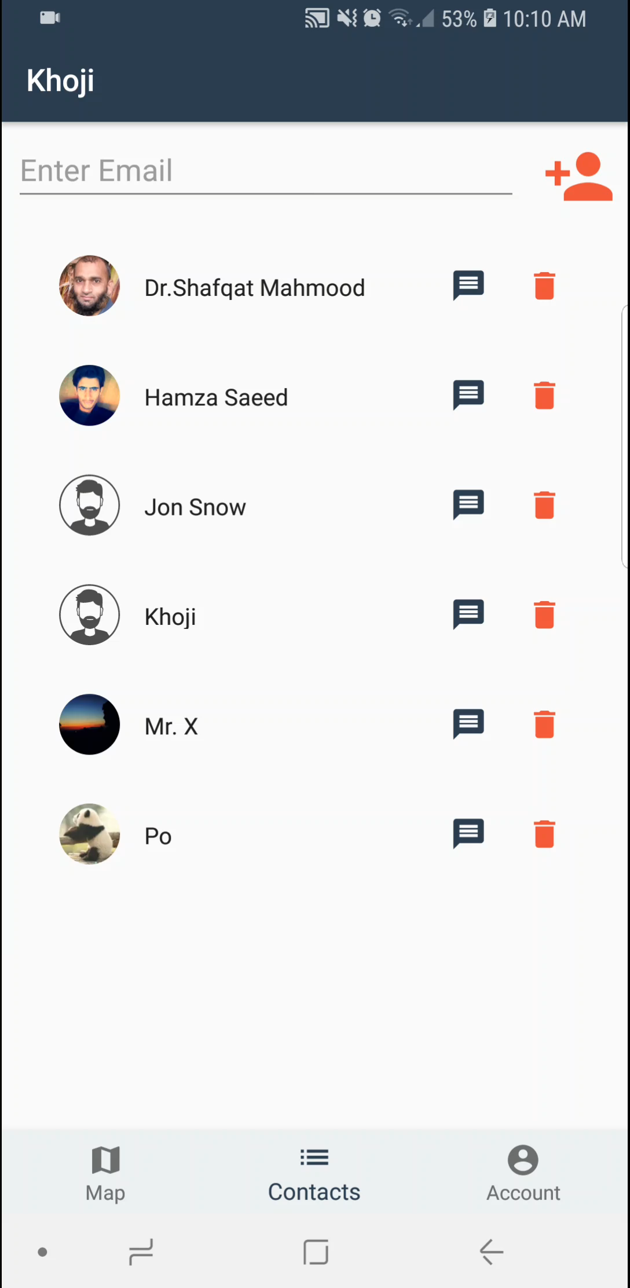
Chat-Bot Integration
We used DialogFlow, a development suite by Google to create conversational user interfaces.
Once a user initiates a conversation with the Bot, we first send the user query to the DialogFlow server, which tries to understand the query and responds accordingly. We save both, the query and the response, in the remote Firebase database and update the UI to show the messages.
Using this model, we can easily update each module without affecting the other.

Slide 21
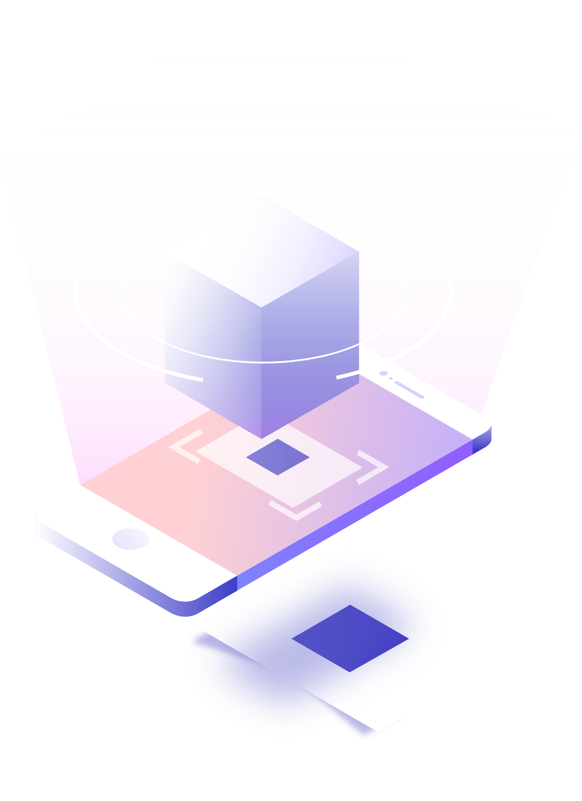
Thanks
https://github.com/aadimator/khoji

